Slide 1
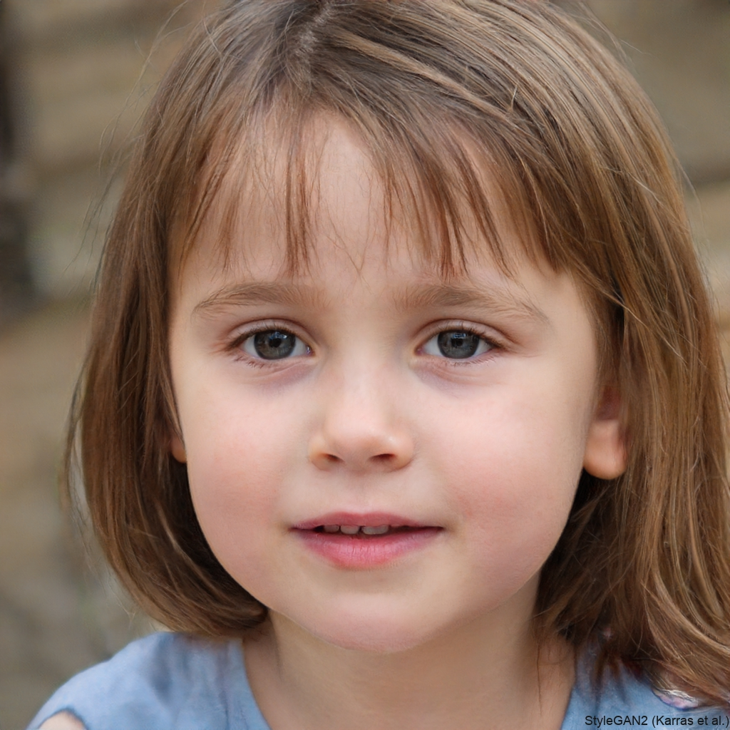

F

Slide 2
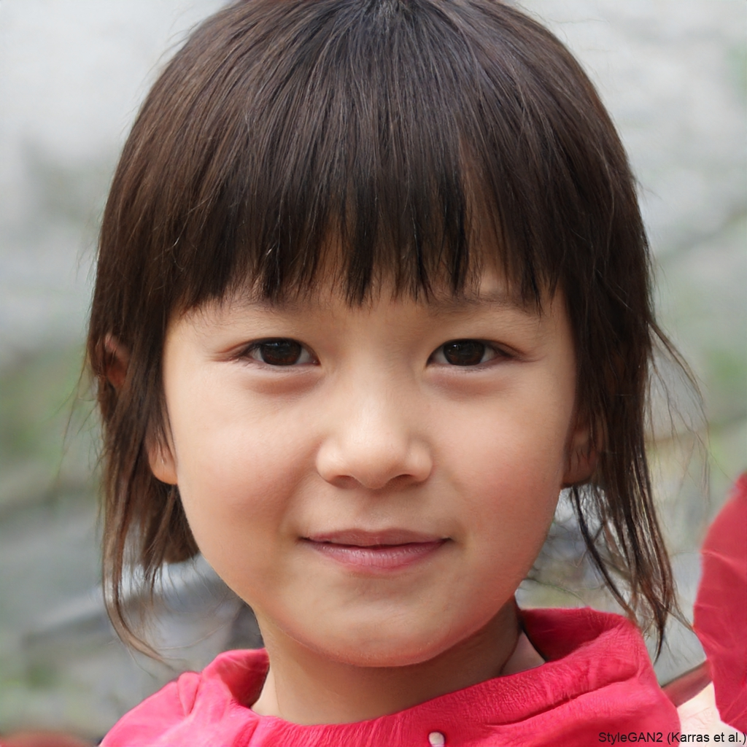

F

Slide 3
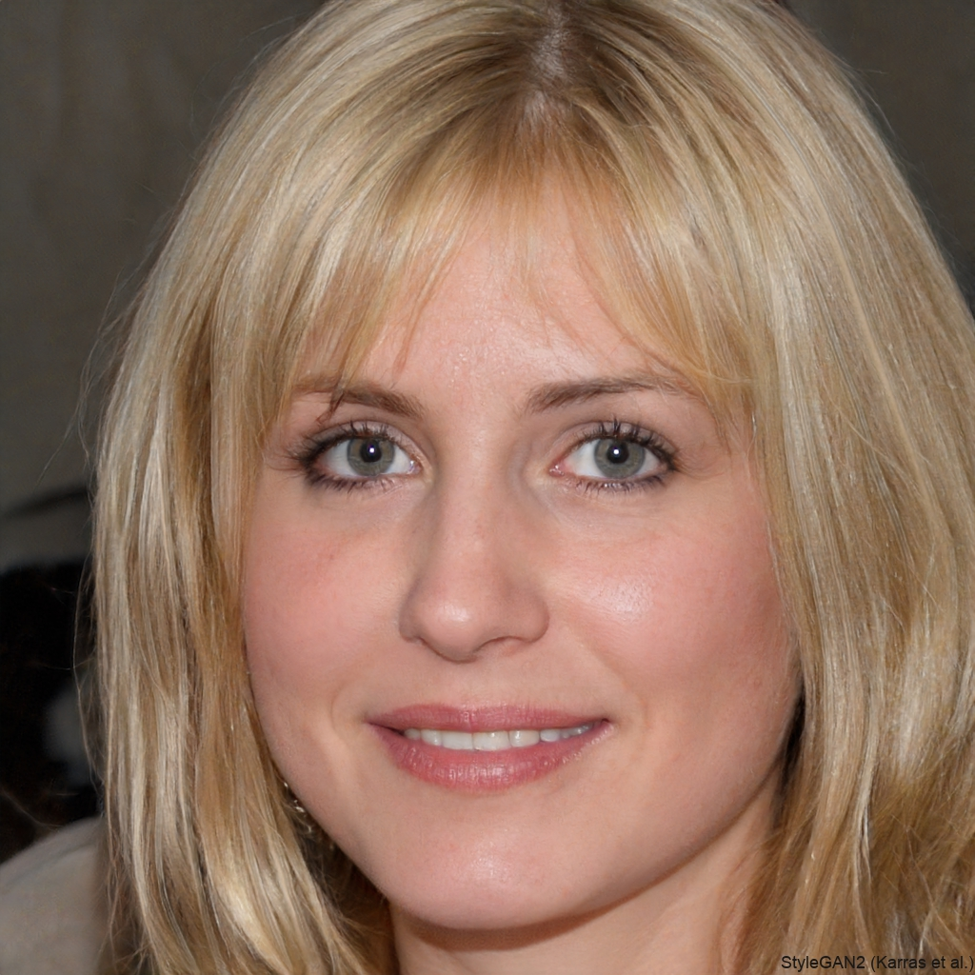

F

Slide 4
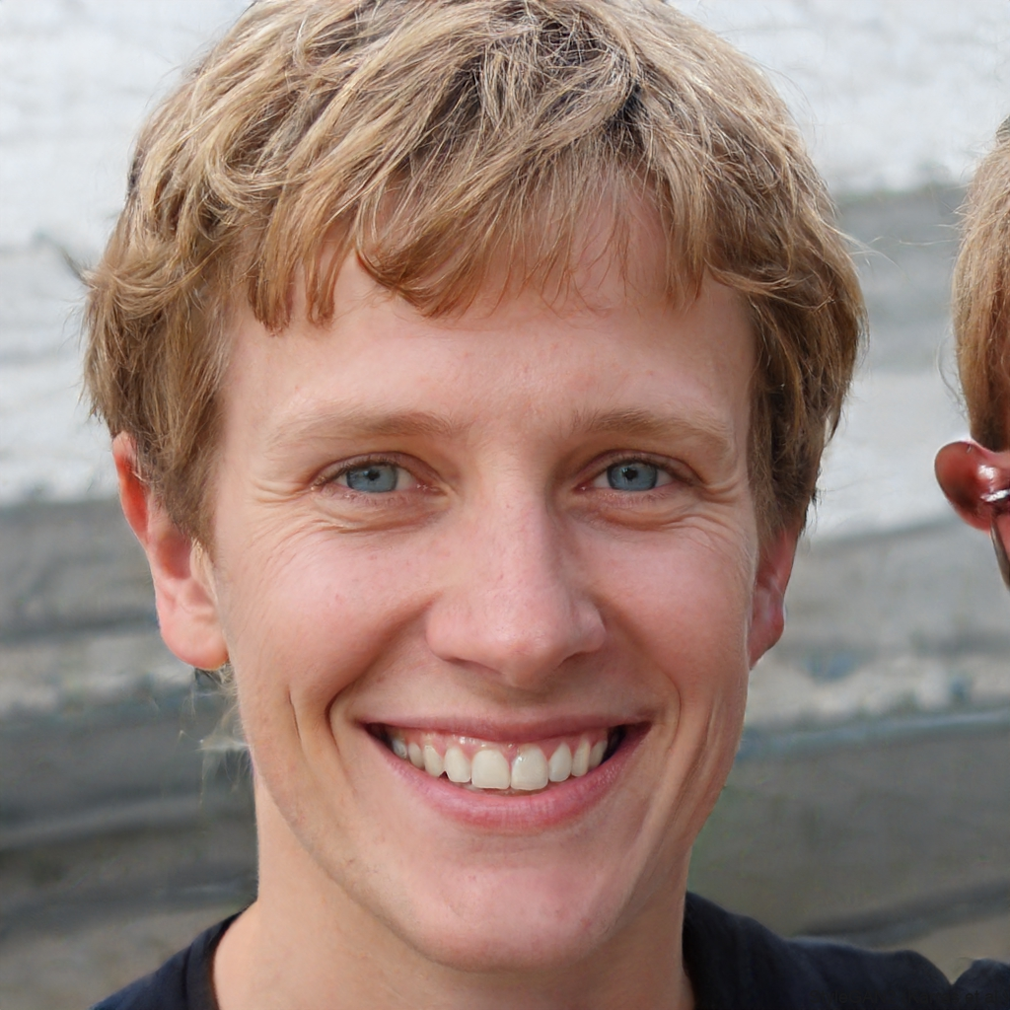

F

Slide 5


F

Slide 6
Generative Modeling

Slide 7
Introduction to Generative Modeling
What is Generative Modeling?
Generative modeling is a type of machine learning.
It involves training a model to produce new data similar to an existing dataset.
Example: If we have photos of horses, a generative model can learn to create new, realistic images of horses.

Slide 8
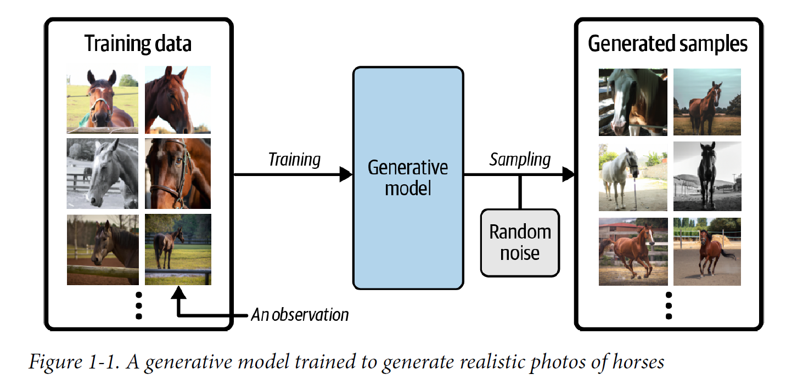

Slide 9
Training Data and Observations
What Do We Need?
A dataset with many examples of what we want to generate, called training data.
Each example in the dataset is called an observation.
For images, features are the individual pixel values.
For text, features could be words or letters.

Slide 10
Building the Model
How Does It Work?
Our goal is to build a model that generates new sets of features.
For image generation, this is hard because there are many ways to arrange pixels.
Only a small number of these arrangements look like the entity we want to generate (e.g., horses).

Slide 11
Probabilistic Nature of Generative Models
Why Probabilistic Models?
A generative model must be probabilistic, not deterministic.
We want to create many different variations, not just the same output every time.
The model should include randomness to create diverse samples.
The goal is to mimic the distribution of the original data and generate new observations that look like they belong to the original dataset.

Slide 12
Deterministic Models
Definition: A deterministic model always produces the same output from a given input. There's no randomness involved.
Example: If we average the pixel values of all horse images in our training dataset, we'll get one average image of a horse. Every time we use this method, we'll get the exact same average image.
Limitation: Deterministic models lack variety. They can't produce new and unique samples because they don't incorporate randomness.

Slide 13
Probabilistic Models
Definition: A probabilistic model incorporates randomness, meaning that it can produce different outputs from the same input. These models generate new data by sampling from a learned distribution.
Example: When we train a generative model on horse images, it learns the underlying distribution of these images. By sampling from this distribution, we can create many different realistic horse images, each unique in its own way.
Advantage: Probabilistic models can generate a wide variety of outputs, making them more flexible and powerful for tasks like image generation.

Slide 14
Why Generative Models Must Be Probabilistic
Diversity: We need the ability to produce multiple, varied outputs that resemble the original dataset but are not exact copies.
Realism: Real-world data is inherently diverse and contains variations. Probabilistic models can better capture and reproduce this diversity.
Flexibility: Probabilistic models can adapt to generate different types of data by learning and sampling from complex distributions.

Slide 15
Introduction to Modeling
Generative vs. Discriminative Modeling
Generative Modeling: Creates new data samples.
Discriminative Modeling: Predicts labels for existing data.

Slide 16
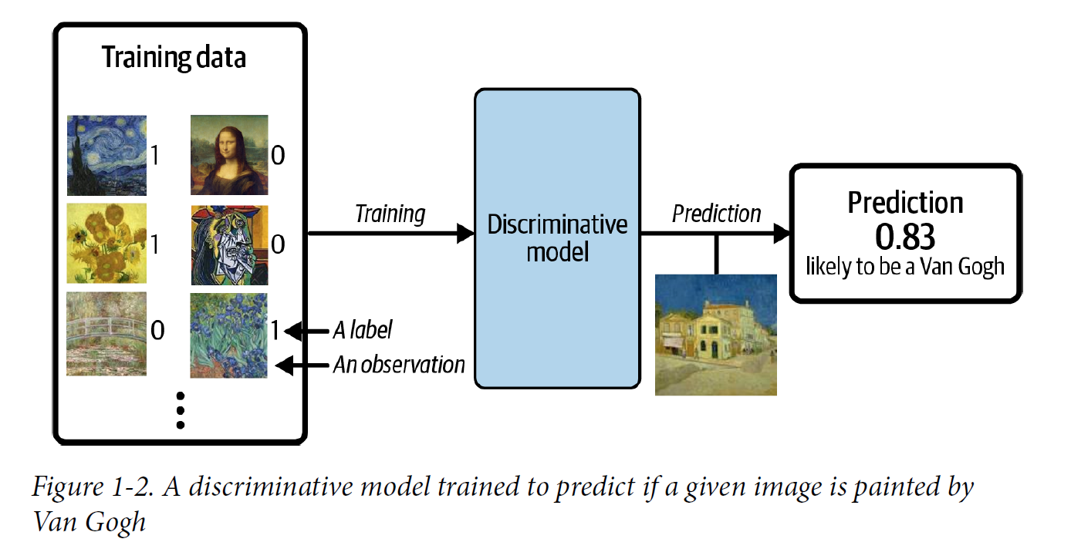
Example Scenario
Dataset of Paintings
Discriminative Task: Predict if a painting is by Van Gogh.
Generative Task: Generate new paintings in Van Gogh's style.

Slide 17
Discriminative Modeling
How It Works
Training Data: Labeled (Van Gogh = 1, Non-Van Gogh = 0).
Model's Goal: Learn features (colors, shapes, textures) that distinguish Van Gogh's paintings.
Output: Probability that a new painting is by Van Gogh.

Slide 18
Generative Modeling
How It Works
Training Data: Unlabelled.
Model's Goal: Understand the underlying distribution of Van Gogh's paintings.
Output: Generate new paintings that resemble Van Gogh's style.

Slide 19
Formal Definitions
Discriminative Modeling
Goal: Estimate p(y∣x)
Explanation: Predict the probability of a label y given an observation x.
Generative Modeling
Goal: Estimate p(x)
Explanation: Model the probability of an observation x. Generate new observations by sampling from this distribution.

Slide 20
Limitations of Discriminative Modeling
Discriminative Model's Capability
Task: Identify if a painting is by Van Gogh
Limitation: Even a perfect model cannot create a new Van Gogh painting
Reason: It only predicts labels for existing images, not generate new ones

Slide 21
Generative Modeling's Advantage
Generative Model's Capability
Task: Generate new paintings that look like Van Gogh's work.
Method: Train on existing Van Gogh paintings and sample from the learned distribution.
Advantage: Can create new images that resemble the training dataset.

Slide 22
Dominance of Discriminative Modeling
Historical Focus
Discriminative Modeling: Main driver in machine learning progress.
Reason: Easier to solve than generative problems.

Slide 23
Difficulty of Generative Modeling
Challenges
Example 1: Easier to predict if a painting is by Van Gogh than to generate a Van Gogh-style painting.
Example 2: Easier to predict if text is by Dickens than to write new text in Dickens' style.
Perception: Creativity seen as a human trait, hard for AI to replicate.

Slide 24
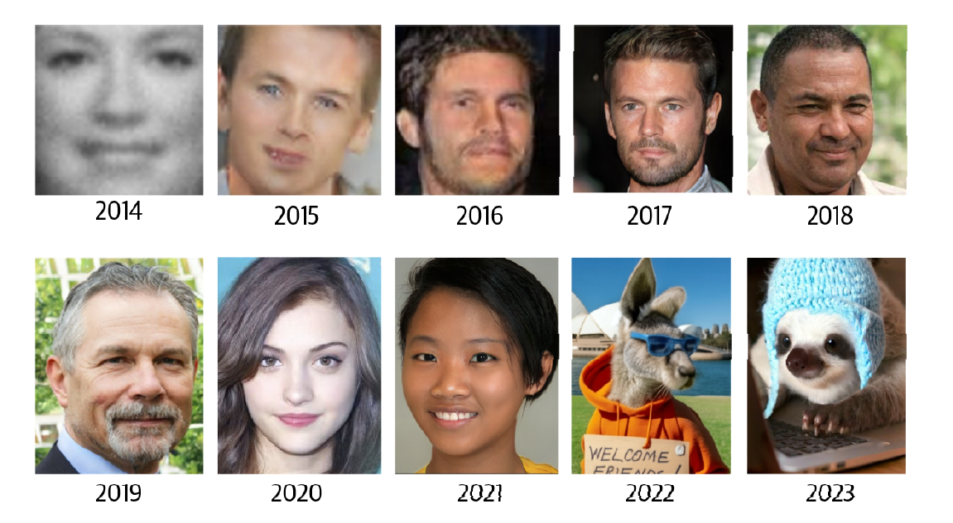
Progress in Generative Modeling
Recent Advances
Technological Maturity: Improved machine learning technologies.
Result: Significant advancements in generative modeling.
Example: Facial image generation progress since 2014.

Slide 25
Practical Applications of Discriminative Modeling
Industry Use
Example: Predicting glaucoma from retinal images.
Limitation: Historically, generative models had fewer practical applications.

Slide 26
Emerging Applications of Generative Modeling
New Business Solutions
Generative Services: APIs for generating blog posts, images, social media content, and ad copy.
Industry Impact: Game design, cinematography, and more are benefiting from generative AI.
Examples: Video and music generation adding value to various industries.

Slide 27
Generative Modeling in AI
Generative Modeling: The Key to Advanced AI
Generative modeling offers practical applications yet to be fully discovered
Complements and surpasses capabilities of discriminative modeling

Slide 28
Generative Modeling in AI
Theoretical Perspective: Capturing Complete Data Understanding
Goal: Train models to understand full data distribution, not just categorization
Challenges:
High dimensionality of feasible output space
Limited number of "valid" creations within datasets

Slide 29
Generative Modeling in AI
Application in Reinforcement Learning
Example: Training a robot to walk
Traditional approach: Trial and error in real or simulated environments
https://youtu.be/fn3KWM1kuAw?si=MrdcVwxckINW21-O
Limitation: Task-specific optimization
New approach: Generative world model
Advantage: Flexibility and efficiency in adapting to new tasks
https://x.com/anag004/status/1820857813478039589

Slide 30
Generative Modeling in AI
Advantages of Generative World Models in AI
Rapid adaptation: Quick testing of strategies in the world model
Computational efficiency: Reduces need for real-world or complex simulations
Versatility: One model can be applied to multiple tasks
Reduced retraining: No need to start from scratch for each new task

Slide 31
Generative Modeling in AI
The Human Mind: Nature's Ultimate Generative Model
Generative modeling is crucial for human-comparable AI
Humans as exemplary generative models in nature
Examples of Human Generative Abilities:
Visual imagination (e.g., envisioning an elephant from any angle)
Narrative creation (e.g., imagining alternative endings to TV shows)
Future planning (e.g., simulating various scenarios for the week ahead)

Slide 32
The Generative Deep Learning Code Base
Generative Deep Learning (keras.io)
https://keras.io/examples/generative/
GitHub - davidADSP/Generative_Deep_Learning_2nd_Edition
https://github.com/davidADSP/Generative_Deep_Learning_2nd_Edition

